Slide 1
Developing a Decentralized File Sharing System with a User
Friendly GUI Building on the Hive2Hive Library

Slide 2
File Sharing
Various protocols
Varying UI styles and levels of security
  DropBox
  BitTorrent
  DC++ (RIP)
  FTP
  Windows Homegroup

Slide 3
Aim
Develop a decentralized, Peer-to-Peer file sharing application
Builds on Hive2Hive and TomP2P libraries
Intuitive and easy to learn GUI for novice computer network users

Slide 4
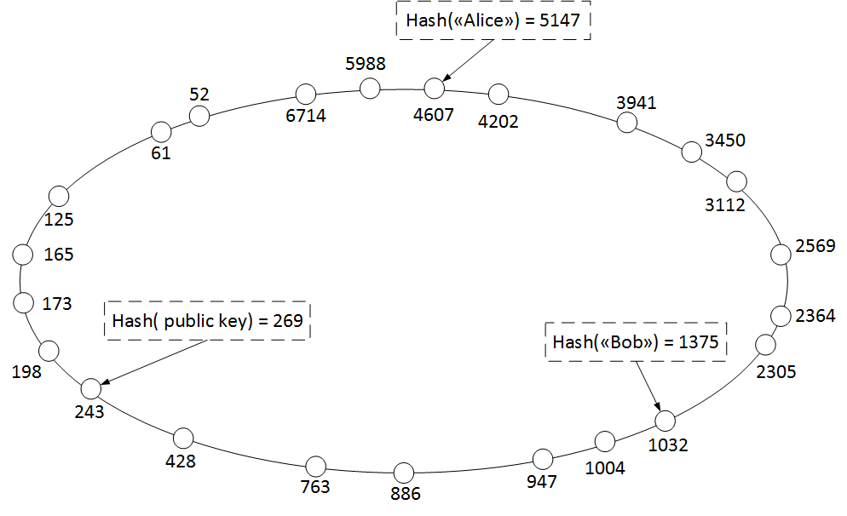
TomP2P
High performance DHT
Handles multiple concurrent connections

Slide 5
Hive2Hive
Open source Java library
Secure, distributed P2P file sync and sharing

Slide 6
Security
A wholly secure system is very difficult to ensure
Hive2Hive provides authentication and encryption services for file security
Focus on a UI that encourages safe usage
  Warnings against potentially unsafe actions
  Configurable security settings
    Whitelist / blacklist peer connections
    Enable requests for all downloads

Slide 7
User Friendliness
Intended user base
  Novice computer network users
Intended use
  Distribution of work / installation files
  Recreational distribution of multimedia
System must efficiently distribute files
Have an intuitive graphical design
Easy to learn
Easy to remember

Slide 8
Evaluating User Friendliness
Must evaluate users' experience with system
Evaluation process:
  Design prototype
  Observe test users as they utilize basic functions
  Question them for their experience
  Further development considering feedback obtained from initial evaluation
  Further testing, evaluation and feedback

